Slide 1

CANADIAN DATA SCIENCE JOB MARKET ANALYSIS REPORT
DATA PREPARATION
SQL Server Integration Services
By: Kulwinder Kaur
Updated: 31/03/2023

Slide 2

1. INTRODUCTION 2. ETL PROCESS 3. 4. SSIS ENVIRONMENT 5. CONFIGURING THE DATA 6. IMPORTING THE DATA 7. CREATING A TABLE 8. Transforming the Data 9. Uploading the Data 10. Data Cleaning in SQL
TABLE OF CONTENT

Slide 3
INTRODUCTION
SQL Server Integration Services (SSIS) is a platform for building high-performance data integration solutions, including extraction, transformation, and load (ETL) packages for data warehousing.
It enable business intelligence by helping IT teams to Extract, Transform and Load data from source databases to new targets like data warehouses and data marts.
Basically It is used to achieve data integration. This platform is designed to solve issues related to data integration and workflow applications.

Slide 4
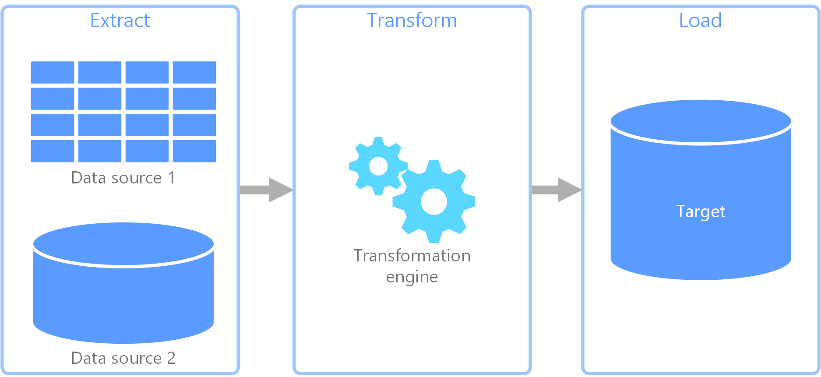
ETL PROCESS

Slide 5

VISUAL STUDIO

Slide 6
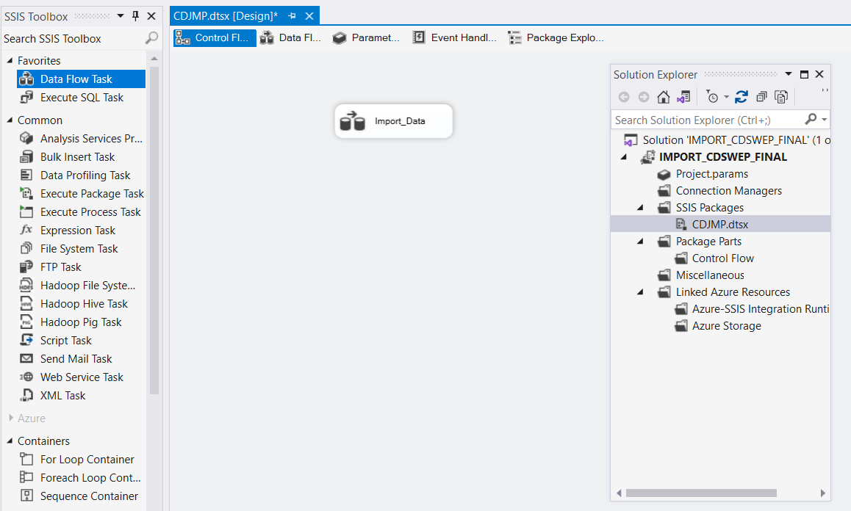
Import the Data
Rename the SSIS Package Name : CDJMP
2. Select Data Flow Task and rename it: Import_Data
3. Double click on Import_Data

Slide 7
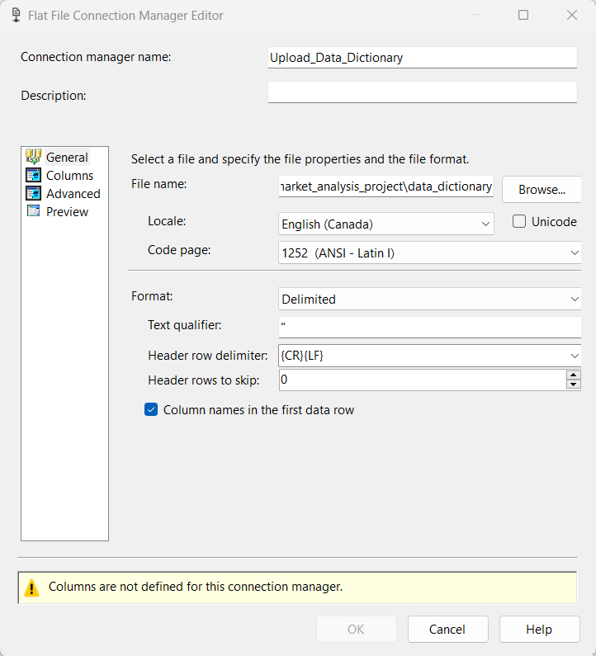
Configuring with Data Dictionary csv file
Rename Connection Manager Name: Upload_Data_Dictionary
copy the
path of my Data Dictionary folder and paste to file name and click browse.
3. Next I will put a double quote (“) for the Text Qualifier. This does not allow data to move from one cell to another

Slide 8
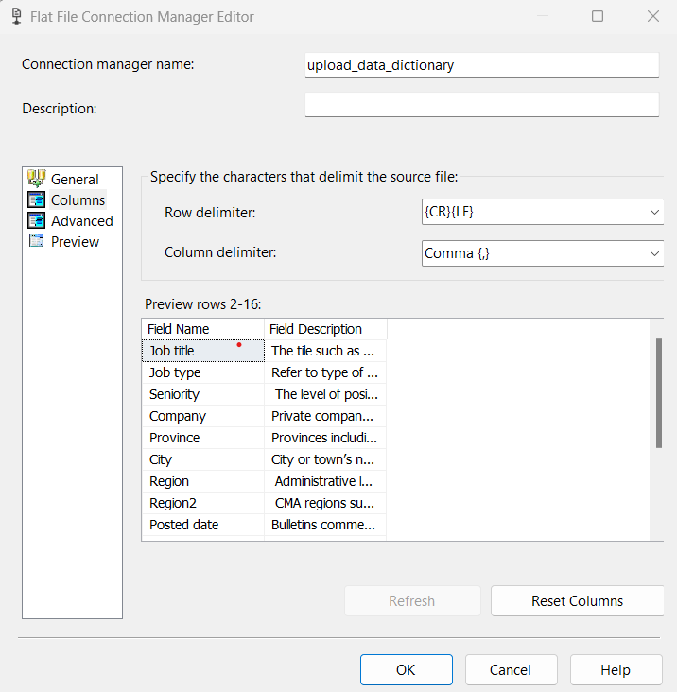
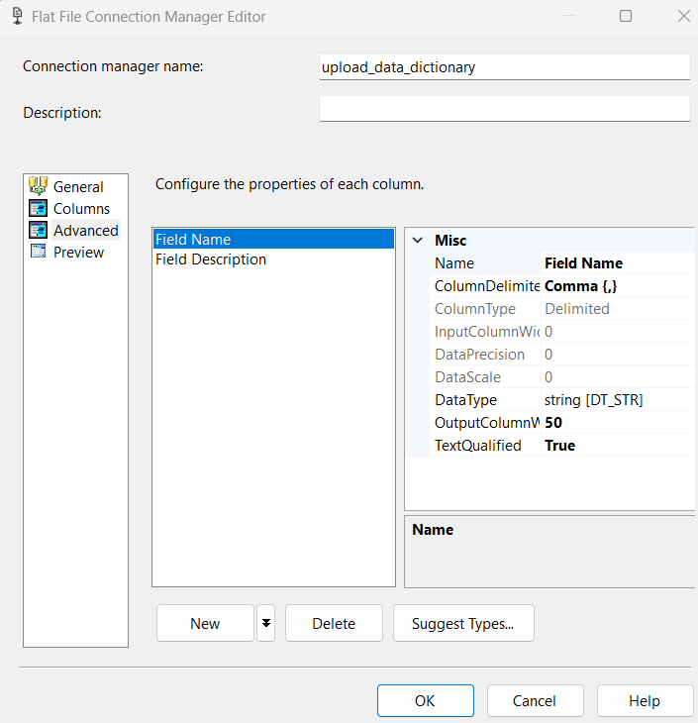
Lookup Data types
1
2
1. Select columns to see if the data looks good
2. Select Advanced and click on Field Description to change character length from 50 to 255

Slide 9
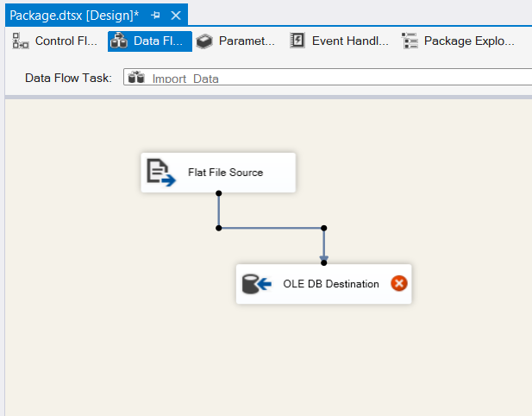
Transform the Data Dictionary file
1. Select OLE DB DESTINATION & connect with Flat File Source.
2. Double click on OLE DB DESTINATION .
3. Double click on New.

Slide 10
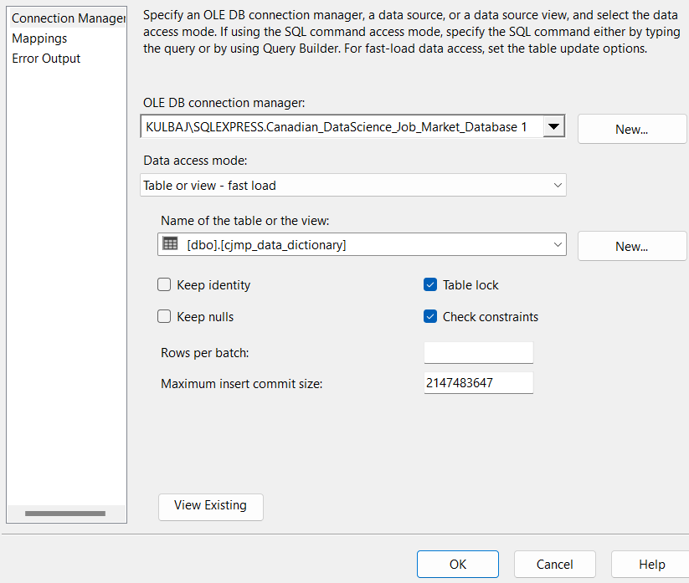
Connect with SQL Server
select database name Saved in SQL Database :
Canadian_DataSciencde_Job_Market_Database
2. click ok.

Slide 11
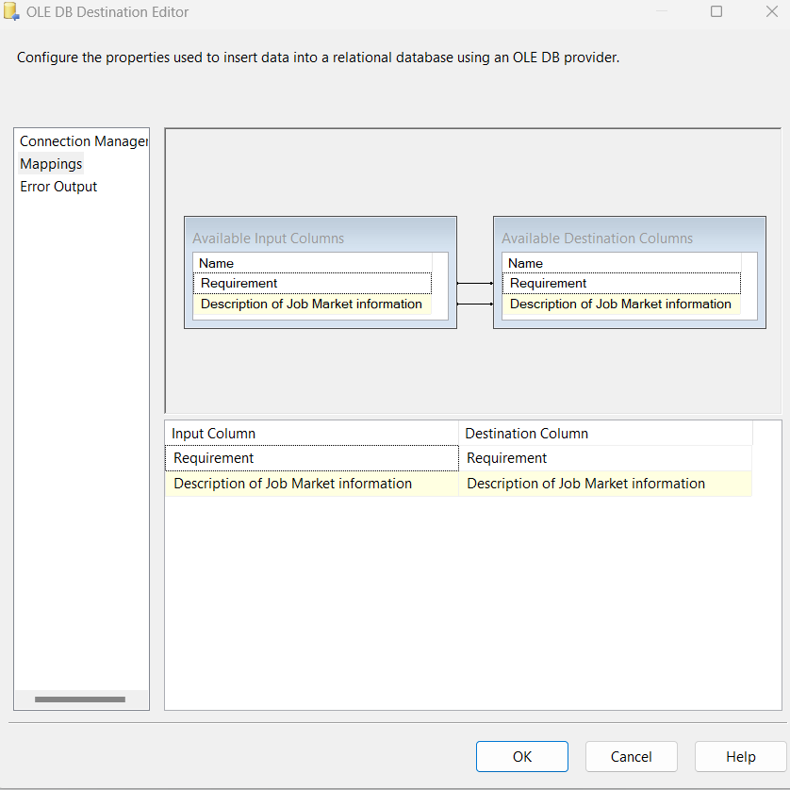
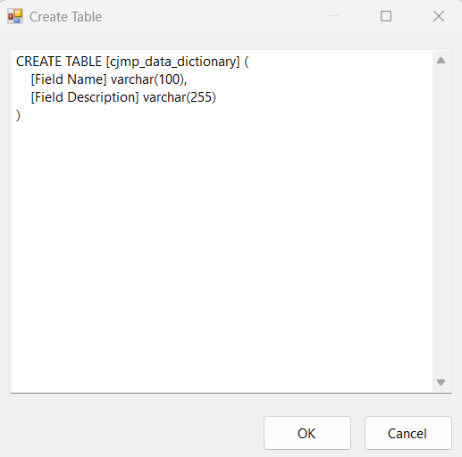
Creating a Table in SQL
create table name : cjmp_data_dictinary
Click ok.
2. Check mappings & Error Output,
Click on ok if its OK.

Slide 12
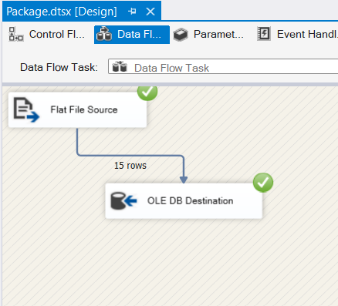
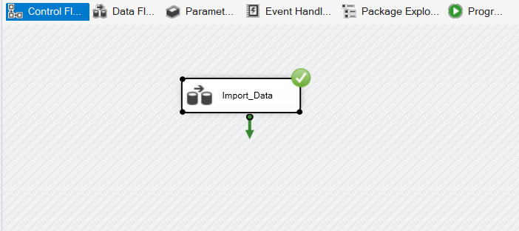
Transformed the data Properties
1. Select control flow and right click on Import_Data then click on execute to get data into the database.
2. Select Data Flow to see rows was imported successfully.

Slide 13

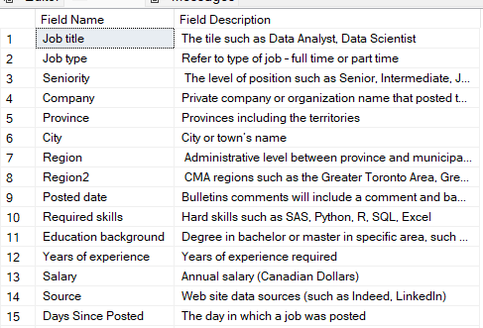
Loaded the Data Dictionary in SQL

Slide 14
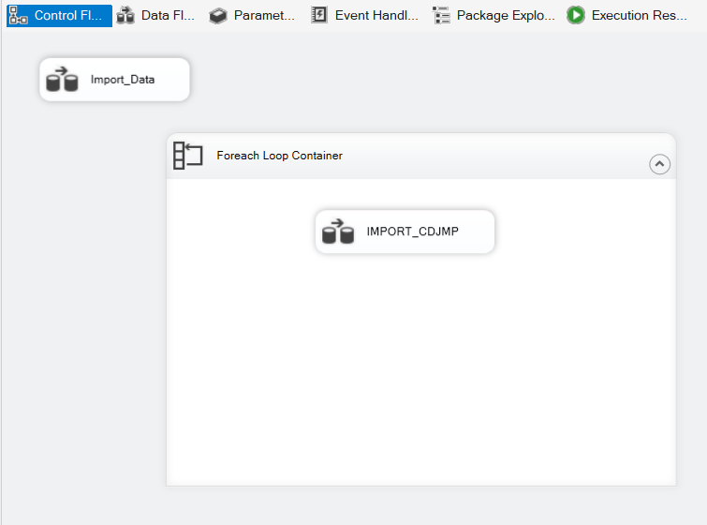
Configuring Data flow
Select Foreach Loop Container.
Drag the Data Flow Task into the Foreach Loop Container.
Rename it : IMPORT_CDJMP
4. Double click on Foreach Loop Container.

Slide 15
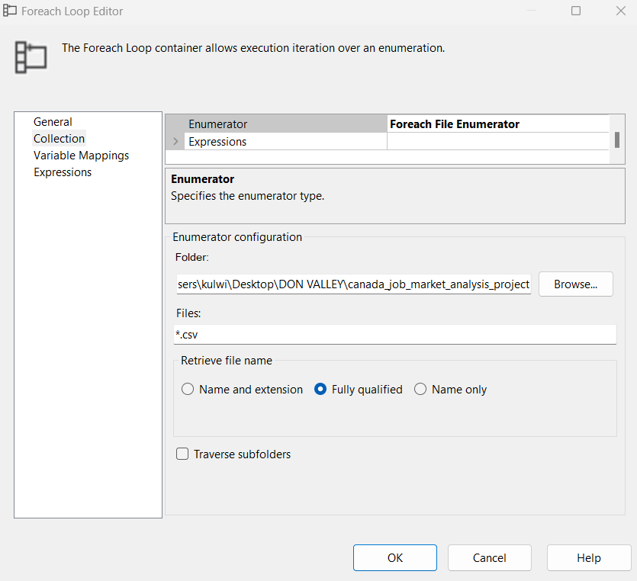
Connect CSV files folder with ForEach Loop
1. Select connection & change Enumerator to Foreach File Enumerator
2. Paste the path in which I want the container to be looking through.
3. Finally it will look into the folder for any file of a *.csv
4. CLICK OK.
5. Double click on IMPORT_CDJMP
2
1
3
4
5

Slide 16
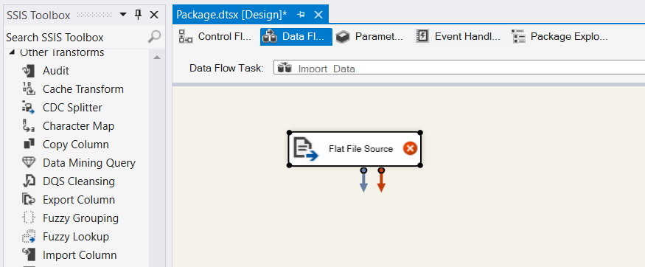
Import Flat file source
Select Data Flow Task,
Drag Flat File Source
& Double click.

Slide 17
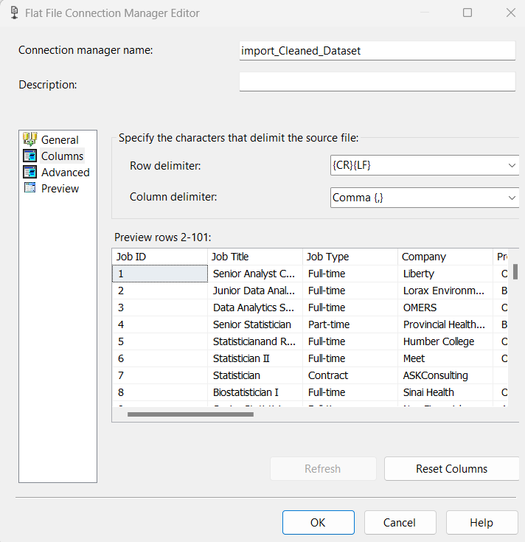
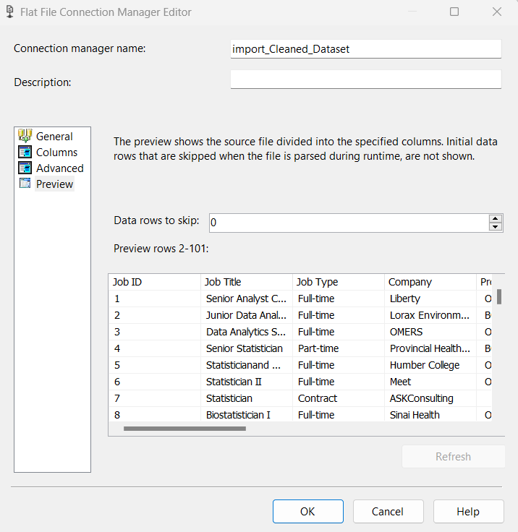
Lookup Data Type Rows
1. Click on Columns to preview it.
2. Click on Advanced & Preview it.

Slide 18
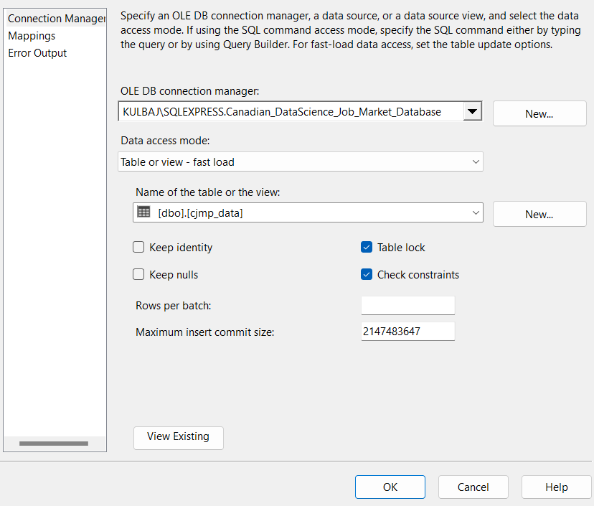
Connect with SQL Server
1. Select OLE DB DESTINATION & connect with Flat File Source.
2. Select the database name saved in sql : Canadian_DataScience_Job_Market_Database
3. Select name of the table: cjmp_data
4. click on New.

Slide 19
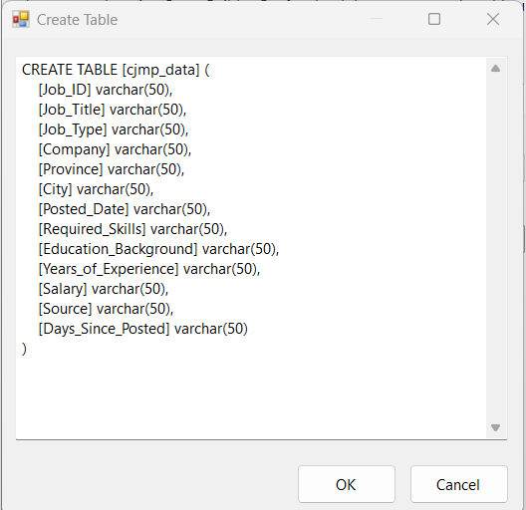
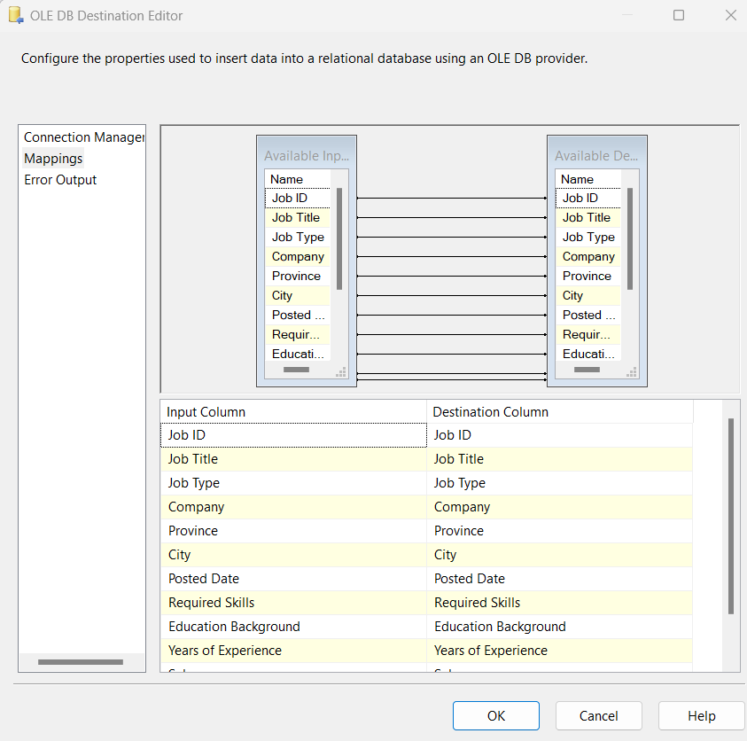
Creating table name
Configuring Lookup Transformation
create table name : IMPORT_CSV_DATA
Click ok.
2. Check mappings & Error Output,
Click on ok if its OK.

Slide 20
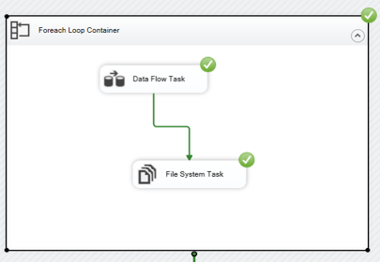
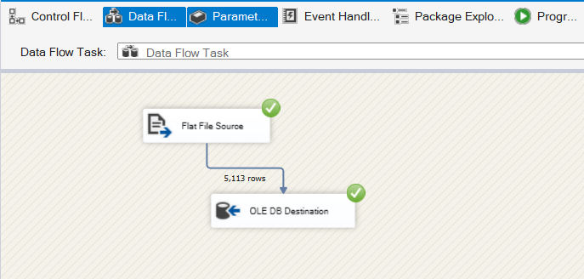
Transformed the CSV files in SSIS

Slide 21
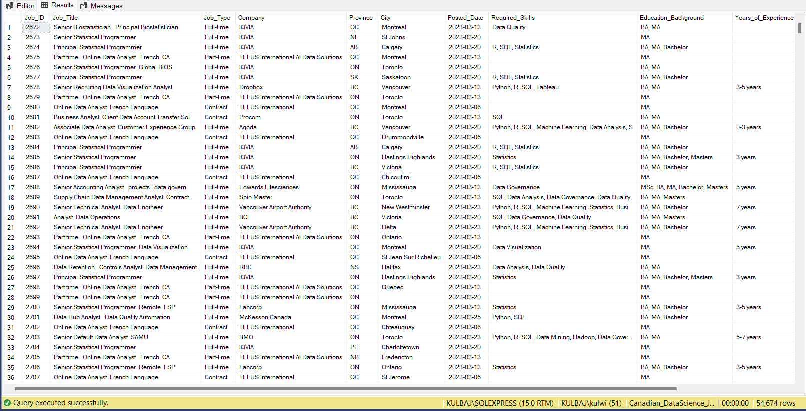
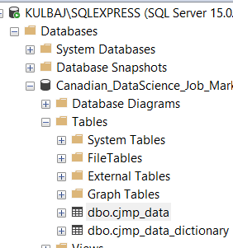
Uploaded the Data in SQL
1
1. Lets check SQL Management Studios in-order to see the tables created.
2. Check table cdsjma_data_dictionary

Slide 22
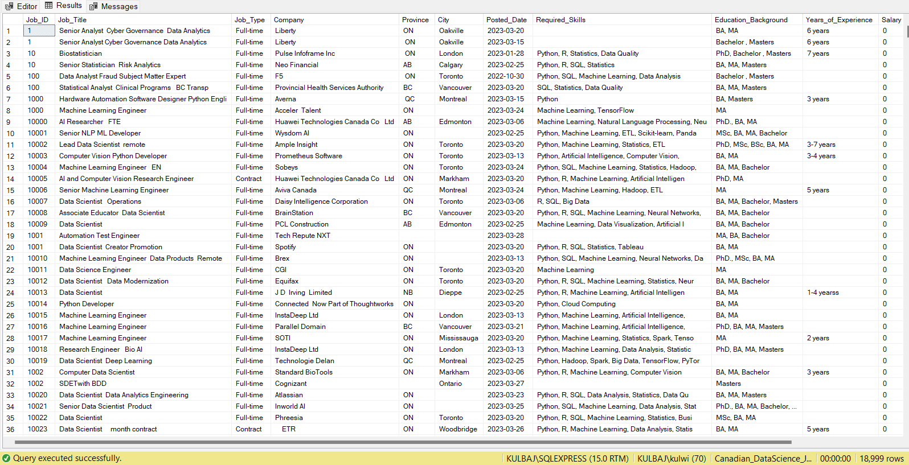
Removing Duplicate Data in SQL
It can help improve query performance and save storage space. After cleaning the duplicate values, we have total 18,999 ROWS.

Slide 23
Conclusion & Analysis
SSIS can combine data from multiple sources into a single package.
The process of developing ETL based solutions is generally faster than other methods.
Created an accurate, reliable, and streamlined data flow in SSIS with the help of SQL

Slide 24
Question ?

Slide 25
THANK YOU

